Slide 1

Data 300 Recap
Tai, Thomas, Sam

Slide 2
Data 300
We all had the same syllabus and same Professor, Professor Odongo
We all took Data 300 Fall 2023 (last semester)

Slide 3
Refreshing on definitions
Unit/object: an item we observe
Observation: piece of information recorded for each unit
Variable: characteristic that may vary from unit to unit
In most datasets, every row is an observation, every column is a variable
Predictor: independent variable or variable used to predict a response
Response: dependent varibale or variable being predicted
Eg: Income = 5,000$ * years of education + unaccounted error
Sometimes your analysis might not need a Response variable – Unsupervised LMs (covered in DATA180)
Otherwise, the models are Supervised LMs (major focus in DATA300)

Slide 4
Supervised Machine Learning
There are always 2 types of tasks in supervised ML:
Prediction: to predict the response y for out-of-sample units
Interpretation: to explain the relationship between response y and predictors X using the sample
We measure the quality of a model with these two tasks in mind

Slide 5
Supervised Machine Learning
Generally, a supervised learning model assumes that there is the following relationship between the predictors X and the response y: y=f(X)+ ∈
In which:
only one response variable y
one or multiple predictors X
f(X) stands for some function of X
∈ (epsilon) is the error term, standing for the part of the response that cannot be explained by X

Slide 6
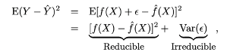
Supervised Machine Learning
Generally, a supervised learning model assumes that there is the following relationship between the predictors X and the response y: y=f(X)+ ∈
We need to estimate this function f(X) because:
It is the only way to approximate y whenever we have information on X
Why can we only approximate the response y?
The goal of statistical learning is to minimize the reducible error.

Slide 7
Supervised Machine Learning
Example: Assuming the response variable is customers’ monthly expenditure, think of a few ways to measure the performance of the following model:
 | True expenditure | Model predicted expenditure
Customer 1 | $100 | $60
Customer 2 | $120 | $200
Customer 3 | $40 | $50
Customer 4 | $10 | $0
Customer 5 | $80 | $100

Slide 8
Supervised Machine Learning
Example: Assuming the response variable is customers’ monthly expenditure, think of a few ways to measure the performance of the following model:
There are a lot of different ways to measure the quality of fit of a model, but they are all about comparing the true response variable y and the predicted response variable y ̂.

Slide 9
Supervised Machine Learning
Example: Assuming the response variable is customers’ monthly expenditure, think of a few ways to measure the performance of the following model:
There are a lot of different ways to measure the quality of fit of a model, but they are all about comparing the true response variable y and the predicted response variable y ̂.
In regression, this is often measured by Mean Squared Error/Mean Absolute Error (MSE/MAE)

Slide 10
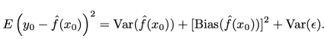
Supervised Machine Learning
MSE can be decomposed to

Slide 11
Supervised Machine Learning
MSE can be decomposed to
There are 3 components in MSE:
Variance of the model
Bias of the model
Irreducible variance that cannot be controlled by the model

Slide 12
Bias-Variance Tradeoff
MSE can be decomposed to
There are 3 components in MSE:
Variance of the model
The amount of change in the model when we change the training set
Bias of the model
The error introduced by using the model to approximate a real life problem
Irreducible variance that cannot be controlled by the model

Slide 13
Bias-Variance Tradeoff
MSE can be decomposed to
There are 3 components in MSE:
Variance of the model
The amount of change in the model when we change the training set
Tend to be low if the model is simple and less flexible
Bias of the model
The error introduced by using the model to approximate a real-life problem
Tend to be low if the model if the model is flexible and complicated
Irreducible variance that cannot be controlled by the model

Slide 14
Bias-Variance Tradeoff
MSE can be decomposed to
Hence, it is challenging to find a model that can reduce variance and bias at the same time!

Slide 15
Linear Regression
Definition: Linear Regression is to assume a linear relationship between a predictor and a response

Slide 16
Linear Regression
Definition: Linear Regression is to assume a linear relationship between a predictor and a response
So what is a linear relationship?

Slide 17
Linear Regression
Definition: Linear Regression is to assume a linear relationship between a predictor and a response
So what is a linear relationship?
A linear relationship must have the following form: y = a + bx
where x is a predictor, and y is the response. Further, a is the intercept, b is the slope
When there are multiple predictors, LR take in the form:
y = b₀ + b₁x₁ + b₂x₂ + … + b_{D}x_{D} where D is the total number of variables

Slide 18
Linear Regression
Definition
Objective: the goal of LR is to calculate b₀, b₁, b₂, …, b_{D} so that the model best fits the training set

Slide 19
Linear Regression
Definition
Objective: the goal of LR is to calculate b₀, b₁, b₂, …, b_{D} so that the model best fits the training set
So how do we define 'fit'?

Slide 20
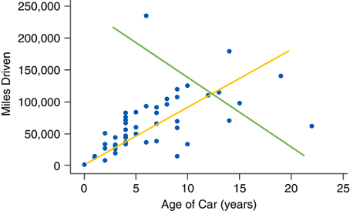
Linear Regression
So how do we define 'fit'?
Which line is a better fit? Green or yellow?

Slide 21
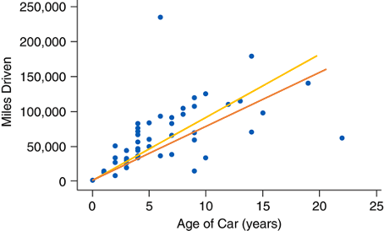
Linear Regression
So how do we define 'fit'?
The classical way to decide fit is to measure how big of a mistake a model made on the training set

Slide 22
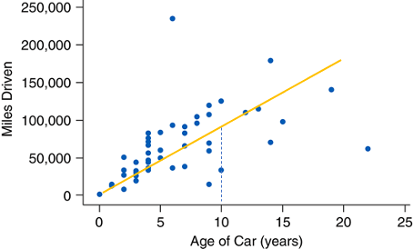
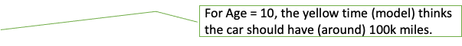
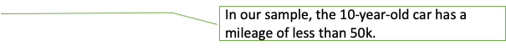
Linear Regression
So how do we define 'fit'?
The classical way to decide fit is to measure how big of a mistake a model made on the training set
In other words, the model has made a (100k-50k) mistake for this sample unit

Slide 23
Linear Regression
So how do we define 'fit'?
We call this a residual

Slide 24
Linear Regression
Definition
Objective:
the goal of LR is to calculate b₀, b₁, b₂, …, b_{D} so that the model best fits the training set
We also want to minimize the residual for each sample unit

Slide 25
Linear Regression
Definition
Objective:
the goal of LR is to calculate b₀, b₁, b₂, …, b_{D} so that the model best fits the training set
We also want to minimize the residual for each sample unit
Specifically, it is to minimize the sum of squared residuals by using the Ordinary Least Squared (OLS) method

Slide 26
Linear Regression
Definition
Objective
Potential problems

Slide 27
Linear Regression
Definition
Objective
Potential problems:
Identify non-linearity in the data

Slide 28
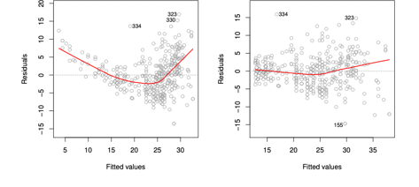
Linear Regression
Definition
Objective
Potential problems:
Identify non-linearity in the data
Given “model” as the generated linear regression model in R, plot (model) gives a residual-fitted value plot.
A plot with obvious pattern would indicate
non-linearity (left)

Slide 29
Linear Regression
Definition
Objective
Potential problems:
Identify non-linearity in the data
Collinearity

Slide 30
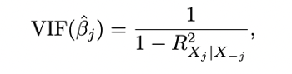
Linear Regression
Definition
Objective
Potential problems:
Identify non-linearity in the data
Collinearity
Refers to two variables strongly relating to each other
Usually measured by Variational Inflation Factor (VIF) with common thresholds VIF > 5 or VIF > 10 for high collinearity

Slide 31
Linear Regression
Definition
Objective
Potential problems:
Identify non-linearity in the data
Collinearity
Error terms

Slide 32
Linear Regression
Definition
Objective
Potential problems:
Identify non-linearity in the data
Collinearity
Error terms
One assumption in linear regression is the independence of error terms, i.e., model making a mistake on sample unit i does not mean this model will likely make the same mistake on unit i+1.

Slide 33
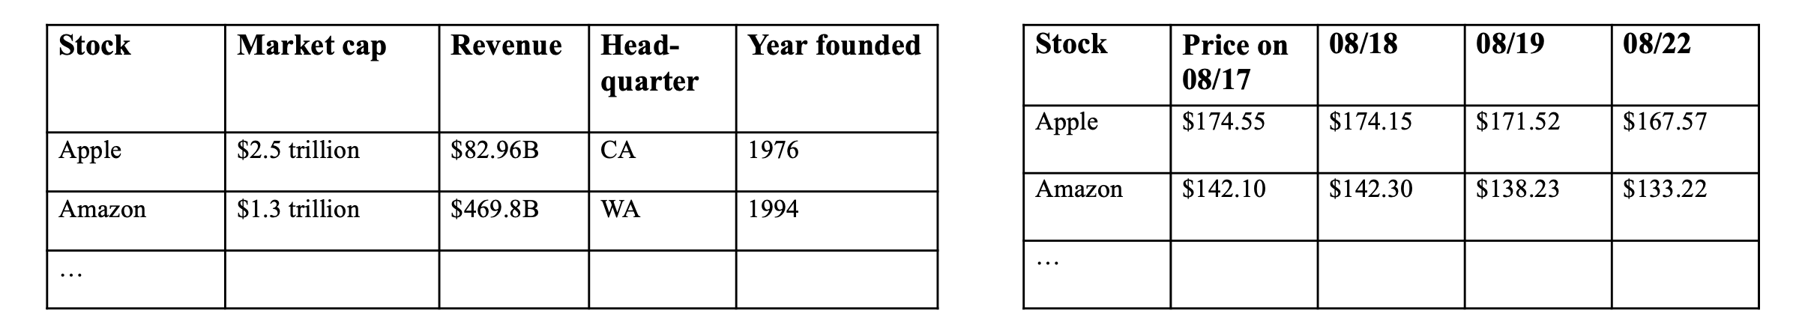
Time Series
Observe two datasets

Slide 34
Time Series
Observe two datasets
The left one: different characteristics of the sample unit recorded at a given point in time. (cross-sectional dataset)
The right one: One characteristic (stock price) recorded at different points in time.

Slide 35
Time Series
Definition:
In data analysis, a time series refers to a sequence of data points measured or recorded at successive points in time, typically at uniform intervals.
A time series dataset is a dataset with N sample units with only ONE variable, but this variable is recorded on T different time stamps.
Time series data can be collected across various domains, such as finance, economics, weather forecasting, and signal processing.

Slide 36
Time Series
Definition
Time series in Linear Regression
Eg: we want to predict housing price using seasons
price= β_2∗spring + β_3∗summer + β_4∗fall + β_5∗winter + ∈
Seasonality in time series analysis refers to any short-term repeating pattern, i.e., it could be yearly/daily/monthly, and they would all be called “seasonally”.

Slide 37
Time Series
Definition
Time series in Linear Regression
Workflow in Time Series data

Slide 38
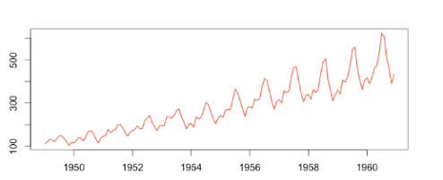
Time Series
Definition
Time series in Linear Regression
Workflow in Time Series data
Step 1: Plot out data
Determine the following: trend, seasonality, outliers, long-run cycle, whether variance is constant, any abrupt changes.

Slide 39
Time Series
Definition
Time series in Linear Regression
Workflow in Time Series data
Step 1: Plot out data
Step 2: Determine if a time series is stationary or not
A stationary time series is a time series with no predictable pattern in the long-term.
If a process is non-stationary/has a predictable trend, we need to convert it to a stationary process first

Slide 40
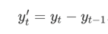
Time Series
Definition
Time series in Linear Regression
Workflow in Time Series data
Step 1: Plot out data
Step 2: Determine if a time series is stationary or not
A stationary time series is a time series with no predictable pattern in the long-term.
If a process is non-stationary/has a predictable trend, we need to convert it to a stationary process first
Differencing is often used to make a process stationary, should
never need to do more than twice (second-order differencing)

Slide 41
Time Series
Definition
Time series in Linear Regression
Workflow in Time Series data
Step 1: Plot out data
Step 2: Determine if a time series is stationary or not
Step 3: Build the model using the stationary time series

Slide 42
Time Series
Definition
Time series in Linear Regression
Workflow in Time Series data
Step 1: Plot out data
Step 2: Determine if a time series is stationary or not
Step 3: Build the model using the stationary time series
We use autocorrelation function (ACF) plot to identify the number of lags for a Moving Average (MA) model
We use partial autocorrelation function (PACF) plot to identify the number of lags for an Auto Regressive (AR) model
Lags: refer to the values of a time series variable at previous time points. Specifically, a lag of k indicates that the value of the variable at time t is compared with the value of the variable at time t−k

Slide 43
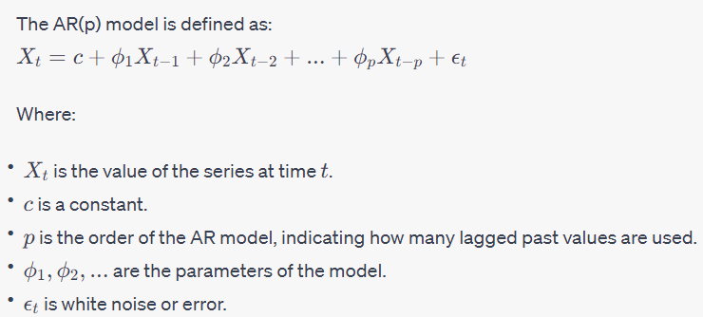
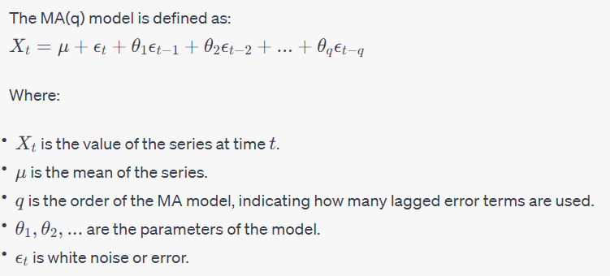
Time Series

Slide 44
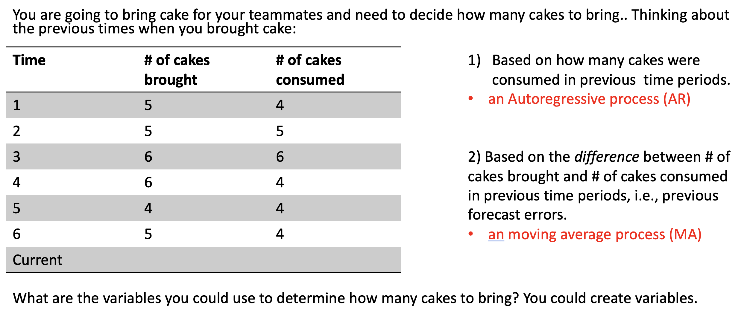
AR vs. MA models

Slide 45
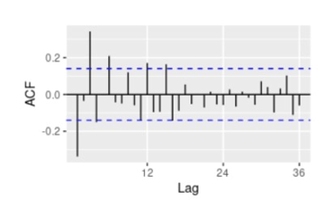
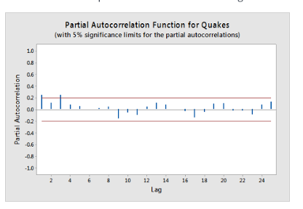
ACF vs. PACF plots
We read the two plots the same way
The red/dotted lines stand for statistically significant. In other words, lag k is strongly correlated if it went outside of the line

Slide 46
Time Series
Definition
Time series in Linear Regression
Workflow in Time Series data
Step 1: Plot out data
Step 2: Determine if a time series is stationary or not
Step 3: Build the model using the stationary time series
Step 4: Make prediction
Step 5: Report error metrics

Slide 47

Linear Classification
Logistic Regression
Linear Discriminant Analysis

Slide 48
Logistic Regression
Logistic Classification- Classifies into a binary variable
Ex. Is this email spam or not? Is this patient diagnosed with cancer or not
We cannot always answer these questions with certainty, but we can say "we are ____ percent sure"
Use a lot of probability to determine the classification
The predictors are not used to predict the binary value of the response variable but rather to predict the probability of the event occurring
Use a threshold to determine if the event will occur
Ex. if over .7, it will occur

Slide 49
Linear Discriminant Analysis
Used to solve multi class classification problems
Identifies patterns to distinguish between different patterns
It can handle multicollinearity in the data
Attempts to maximize the distance between the means between the groups and minimize the variance within each class

Slide 50
Common Quality Checking
Using confusion Matrix
Accuracy- correct predictions/all predictions
Precision- True Positives/all Positives
Recall- True Positives/ True Positives and False Negatives
Cant use for imbalanced classes

Slide 51
Sampling
Cross Validation
Bootstrapping
Imbalanced Classification

Slide 52
Cross Validation
Leave One Out Cross Validation- for each data point in the dataset, the model is trained on all data points except that one data point, and then tested on the one left out.
Gets rid of the randomness in the train-validation set of your data
Better for smaller data sets
K-Fold Validation- split your data into n folds then use one fold for validation and n-1 for training. Repeat this so each fold is used as validation once
Better for larger datasets

Slide 53
Bootstrapping
The Bootstrapping method refers to the procedure of repeatedly sampling (with replacement) from the dataset.
As a result, we could obtain multiple datasets from the initial dataset, and would be able to measure variation among datasets.

Slide 54
Imbalanced Classification
Oversampling- sample (with replacement) from the underrepresented group, until we obtain a group of a similar size.
Makes the smaller group bigger, want to do this with larger data sets/the underrepresented group is still a large number (80,000/20,000)
Undersampling- sample from the overrepresented group, until the two groups are of similar size.
Makes the bigger group smaller, use when we have an already small dataset(100/20)

Slide 55
Variable Selection
Naïve Approach
Complex approach

Slide 56
Naïve Approach
The naïve approach is to build multiple models, using different numbers of predictors, and see which one works the best
Best in this case could be smaller Mean Absolute Error for linear regression, could be better accuracy for classification models, could be having a specific number of significant predictors for generalized linear models.
Forward Selection- start with a model with no predictors, run a simple linear regression and take the variable with the lowest residual sum of squares, continue this until you have the number of predictors you want
Backward Selection- start with all of the predictors in the model, run a linear regression and take out the variable with the highest p-value, continue until you have the number of predictors you want

Slide 57

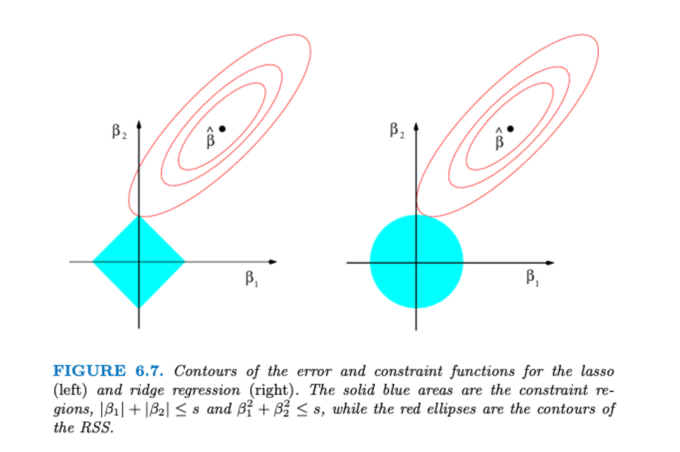

Complex Approach- Shrinkage Methods
Ridge- Ridge Regression adds a penalty term to the traditional linear regression objective function, which is the sum of squared residuals. This penalty term is the squared sum of the coefficients multiplied by a regularization parameter (alpha).
By penalizing large coefficients, Ridge Regression reduces the variance of the model and can help prevent overfitting.
Can shrink the coefficients towards zero but does not set them exactly to zero so it cannot perform feature selection

Slide 58
Complex Approach- Shrinkage Methods
Lasso- Lasso Regression adds a penalty term to the linear regression objective function, but it uses the absolute sum of the coefficients instead of the squared sum like Ridge. Lasso Regression has a regularization parameter (alpha) that controls the strength of the penalty.
Lasso Regression tends to shrink the coefficients towards zero and can set some coefficients exactly to zero, can perform feature selection
Features with coefficients set to zero are essentially removed from the model, making Lasso Regression useful for feature selection and building simpler models.

Slide 59
Tree Based Methods
Decision Trees and types
Random Forests
Sklearn Library

Slide 60
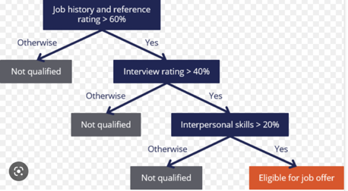
Decision Trees
A Tree Visualized
Root,Terminal, and Internal Nodes
Branches
Regression and Classification Trees

Slide 61
Regression Trees
Splits the data frame at variables until a final region is established
Each split aims to minimize sum of squared residuals
The predictor to split on is decided by the smallest sum of squared residuals
This continues until the inputted number of observations at the final regions are reached (ex: n=5)

Slide 62
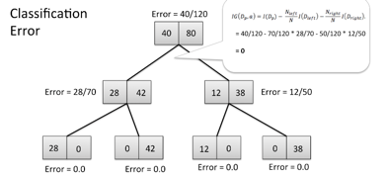
Classification Trees
Similar logic to regression trees but used in classification (binary response variable)

Slide 63
Tree Based Methods
Benefits
Drawbacks
Good Interpretability
Non-Linear Relationships (ensemble method like RF)
Identifies feature importance
Overfitting problem
Computationally Expensive

Slide 64
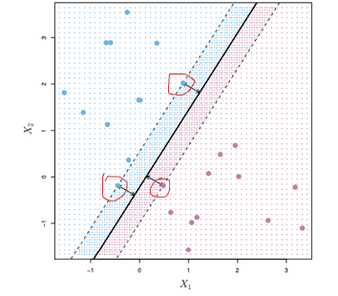
Support Vector Machines
Largely used as a supervised learning classification technique
Calculates a hyperplane that aims to maximize margins
Support vectors are datapoints in the margin

Slide 65
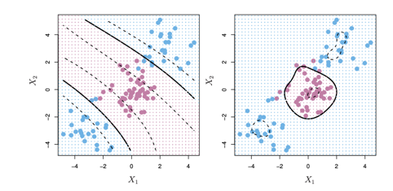
Support Vector Machines
Dimensionality/non-linear Problem
Kernel Solution

Slide 66
Support Vector Machines
Benefits
Drawbacks
Effective in high dimensions (Image recognition)
Effective in small sample sizes
Good Generalization
Low Interpretability
Hard to tune models

